Slide 1
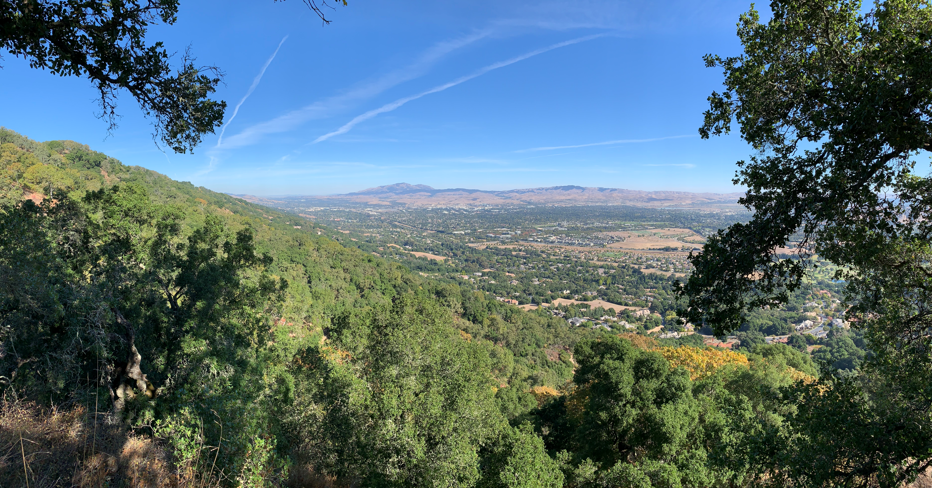
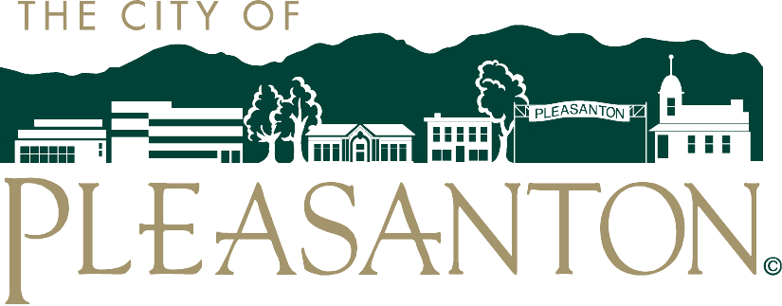
Overview of the City of Pleasanton Urban Forest
Committee on the Energy and Environment Meeting
Wednesday, May 24, 2023

Slide 2
Urban Forest Overview
Tree Preservation Ordinance
City Tree Inventory
Tree City USA Designation
Urban Forest Master Plan

Slide 3
Tree Preservation Ordinance
Adopted by City Council in 1971
  Codified as Chapter 17.16 of the Pleasanton Municipal Code
Recognizes the benefit of trees to the community
Defines what is considered a heritage tree
  Any single-trunked tree with a circumference of 55 inches or more measured four and one-half feet above ground level;
  Any multi-trunked tree of which the two largest trunks have a circumference of 55inches or more measured four and one-half feet above ground level;
  Any tree 35 feet or more in height
Regulates tree removal for all property
Guides new development regarding the retention or removal of trees
Provides pruning and maintenance guidelines

Slide 4
City Tree Inventory
Created in the early 2000’s
Captures the characteristics of City-maintained trees in the urban forest
  Location
  Pruning schedule
  Condition rating
  Species
  General value
Contains approximately 26,000 trees valued at over $63 million
  11% London Plane
  9% Coast Live Oak
  8% Coast Redwood
  6% Chinese Pistache
  6% Valley Oak
  5% Crape Myrtle
  4% Liquidambar
  50% other trees

Slide 5
Tree City USA Designation
Tree City USA since 2016
Designation requires that the City maintains the below standards:
  A tree Board or Department
  A Community Tree Ordinance
  A Community Forestry Program with an Annual Budget of at Least $2 Per Capita
  An Arbor Day Observance and Proclamation
The City did the following in 2022:
  Spent approx. $700,000 on tree care
  Planted around 100 trees
  Pruned around 5,000 trees
  Retained a staff made up of 6 certified arborists

Slide 6
Urban Forest Master Plan
The plan will guide the management of the City’s urban forest for the next 25 years and will include
  A tree inventory update
  A review of the health of the urban forest
  A guide for tree maintenance and tree planting practices to sustain and enhance the urban forest
  An analysis of the environmental programs relating to the urban forest, including the CAP 2.0
  A cost/benefit analysis of the urban forest
  Community engagement and education recommendations
  Tree Preservation Ordinance updates
  A tree map for the public that includes tree locations and species
Specifically regarding the CAP 2.0, the UFMP will
  Analyze carbon sequestration, average pollutant capture, avoided runoff, avoided emissions, and structural and functional value
  Will help to secure funding for implementation of the CAP 2.0
  Provide new tree planting recommendations
  Provide a tree canopy cover analysis

Slide 7
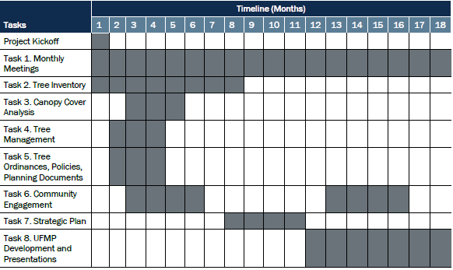
Urban Forest Master Plan
Schedule
March 21, 2023
May 16, 2023
Council Approval

Slide 8
Questions and Comments

