Slide 1
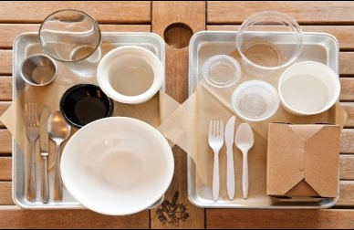
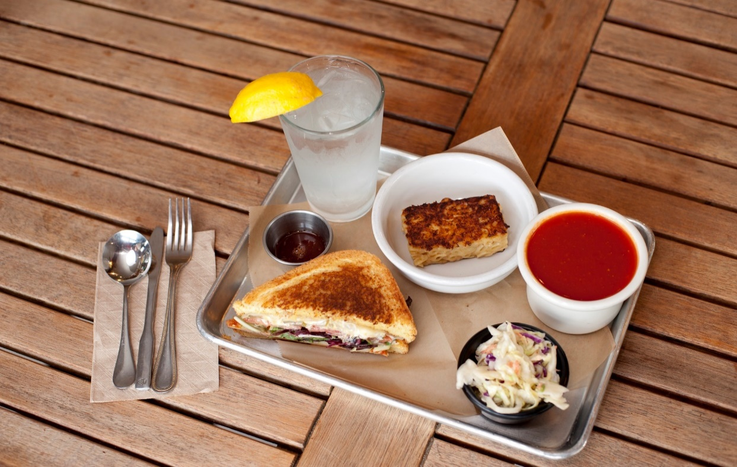


Model Ordinance for Disposable Food Service Ware Reduction and Reuse
ZeeLaura Page, City of Pleasanton
Justin Lehrer, StopWaste
City of Pleasanton
Committee on Energy & the Environment
September 27, 2023
Notes:
StopWaste is a public agency advancing environmental sustainability by helping residents, businesses, schools, and local jurisdictions prevent waste and save energy and water. I lead our reusable foodware project, which aims to facilitate the transition to reusable foodware in all sorts of dining scenarios, making it more convenient and accessible or both businesses and consumers.

Slide 2
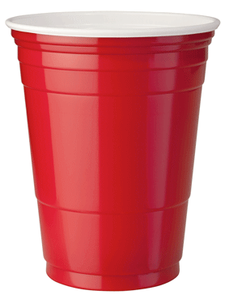
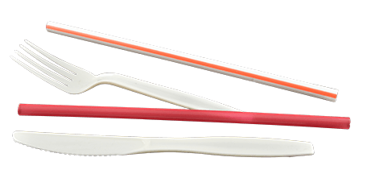
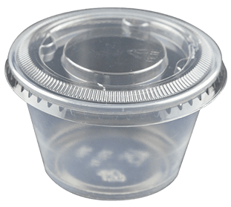

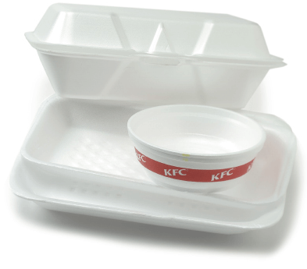
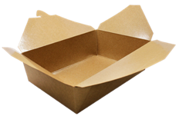
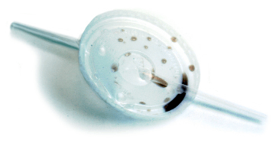
Single-Use Foodware

Slide 3
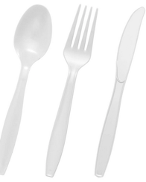
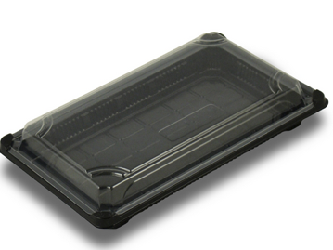
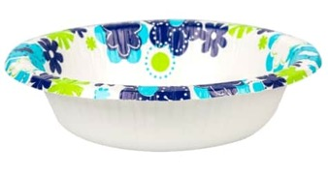
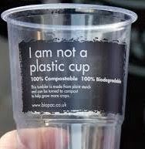
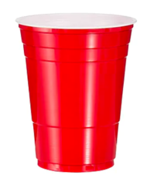

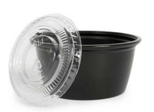
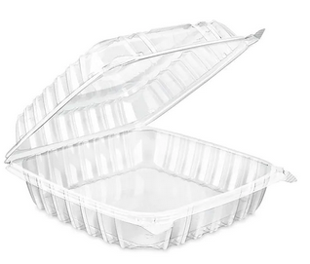
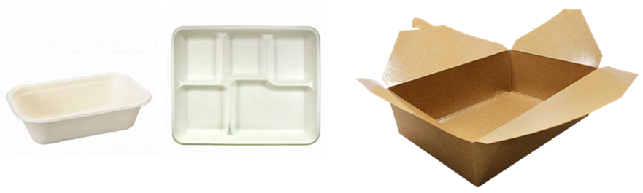
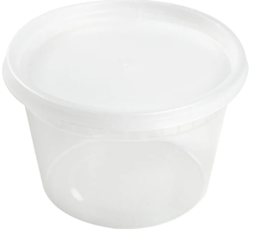
But Take-out Packaging is Recyclable/Compostable, Right?
Notes:
Looking more closely at disposable foodware options.
On the left we have some examples of plastic foodware, sometimes labeled recyclable. For example, clear plastic clamshells are very common, as are the little condiment cups and flatware.
On the right we have some compostable packaging options. It may seem like we could use compostable food ware, or fiber/paper-based food ware as the solution. They continue to evolve, but are not a clear win - there are a host of challenges with them. Let’s take a quick look at both.

Slide 4
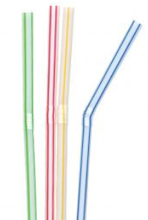
Challenges with “Recyclable” Foodware
Most are not actually recyclable
Tend to end up in the wrong bin
Typically tossed with too much food residue
Possible contamination fees and fines
Notes:
Recycling is not really a viable solution for the endless flow of food ware and other small plastic items. The vast majority of these items are not recyclable, practically speaking. People think they’re recyclable because of the chasing arrows on them. Some may even be collected with the recycling, but MRFs are not well equipped to deal with small-sized items. Even if they make it through this stage of processing, there simply are not robust end markets for these materials.
These items also often include food residue, which is a problematic contaminant in the recycling and can affect the marketability of an entire load. When these foodware items end up in the green bin, which also often happens, they contaminate the compost. For individual businesses, contamination in the bin can lead to violations of the county’s Mandatory Recycling Ordinance and possible fines.

Slide 5
Compostables: Not a Panacea
Most “bioplastics” don’t actually decompose
Plastic film contaminates compost
Unhealthy ingredients: PFAS
Polluting production
High cost
Notes:
Because food contamination makes recycling challenging, and organics are banned from most landfills, composting all food service ware might seem like a good option to consider. Compostable foodware continues to evolve but is not a clear win - there are a host of challenges here.
First it is important to note that there is fiber-based compostable packaging, there is compostable plastic, and there are bio-based plastics that are not compostable. Pretty confusing, right? Bio-based materials do not necessarily break down in compost. Some of them are designed to be recycled with traditional plastic. So this increases the complexity and confusion. But even truly compostable material will only break down under the right conditions.

Slide 6
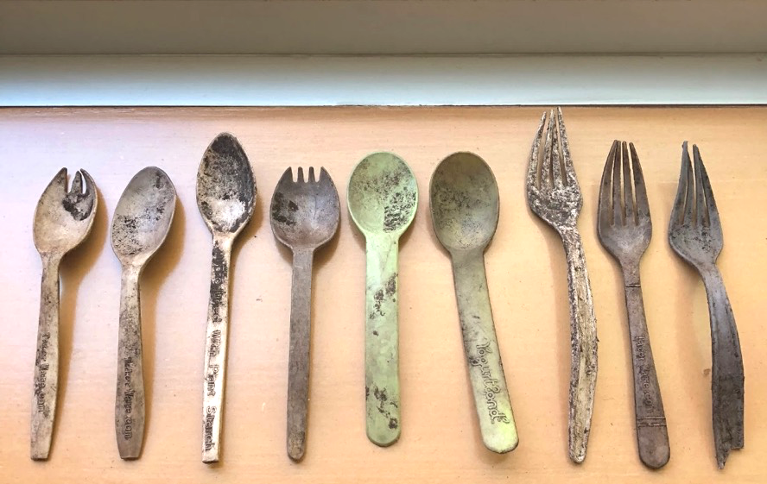
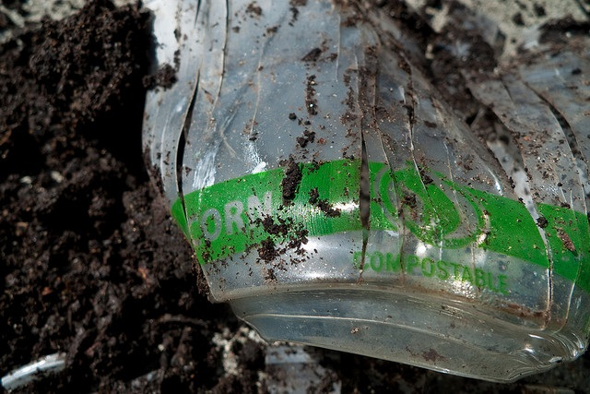
Will it Compost?
Notes:
Pic is of utensils pulled by SW staff from nearly finished compost at a facility that handles some Alameda County material. pic on the right is a clearly labeled compostable plastic cup, still intact in the compost.

Slide 7
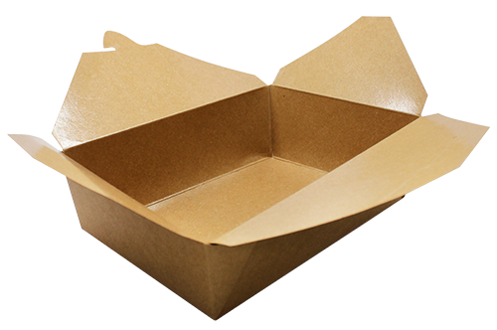
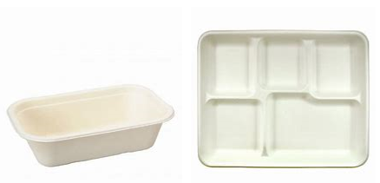
Are compostables the solution?
Fiber-based compostable foodware:
  Thin layer of film plastic
  “poly-coated paper”
  >leads to micro-plastics in soil and water
  Grease barriers with perfluorinated compounds
  >persist in environment and bioaccumulate in living organisms
Notes:
Some fiber-based food ware has a polymer coating to create a moisture barrier. This thin layer of film plastic is a contaminant in the compost and leads to micro plastics in the soil and water.
Other fiber-based items contain a coating used as a grease barrier that contains harmful perfluorinated compounds known as PFAS. These compounds are incredibly effective at repelling grease or water, but they are known to be harmful to the environment and toxic to human health.
Bottom line: the only viable compostables are fiber with compostable plastic liner that is BPI certified (Peet’s Coffee uses such a cup in their Berkeley stores and maybe elsewhere), but sorting and cost issues remain.

Slide 8
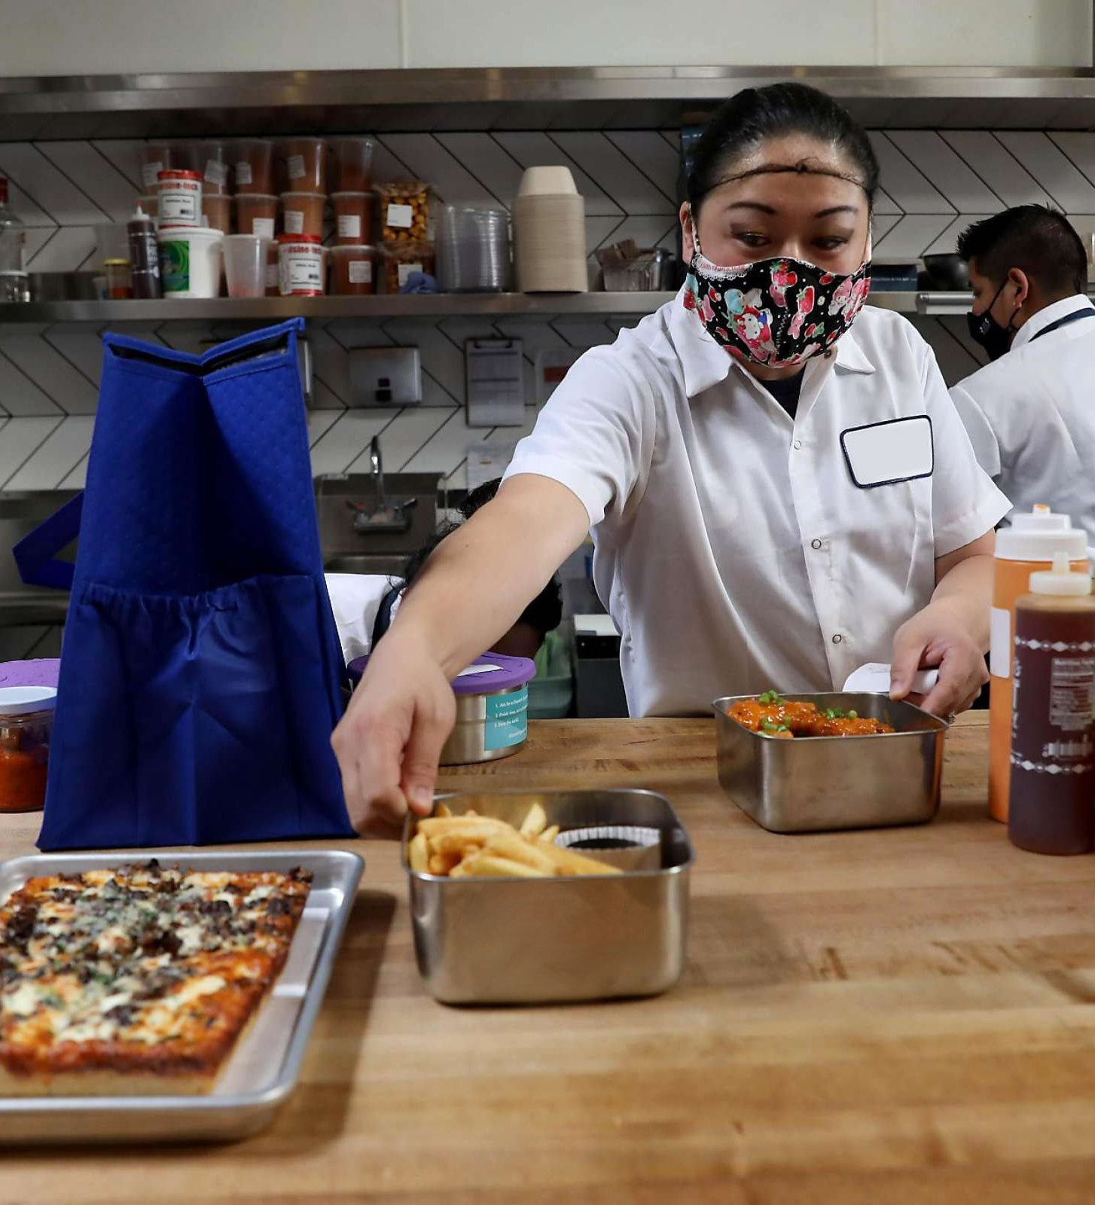
Reusable Foodware Systems
Take-out and delivery
Mobile dishwashing
Institutional kitchens, campuses, bulk meals
Notes:
Include examples of what is happening in Alameda County:
- In Hayward, Chabot College piloted reusabes in their dining hall
- In Berkeley, UC Berkeley has been testing reusables for catered events on campus, the school district has rolled out at 3 sites and is expanding
- In Oakland
In all cities, we have TA team available to support busineses switching to reusables

Slide 9
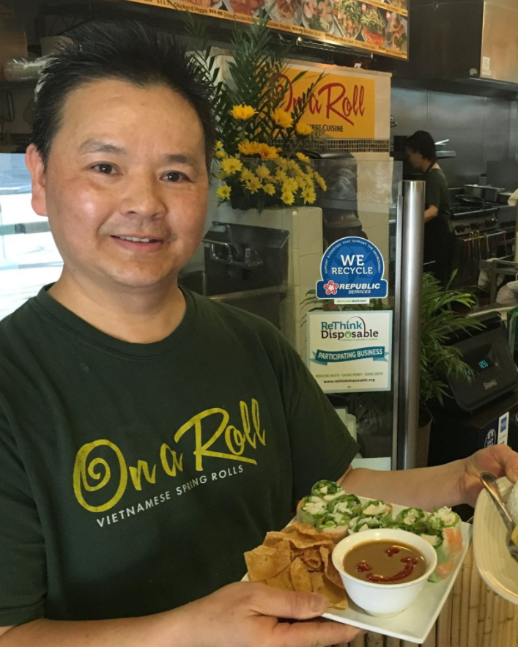
Recent Activity and Plans
Pilot Projects
Technical Assistance
Outreach and Education
Model Ordinance
Notes:
We are here today to focus on our development of a model ordinance but I wanted to also mention that our work in this area is primarily focused on other activities:
Pilot Projects to build infrastructure
TA
Outreach/education – safety of reusables

Slide 10
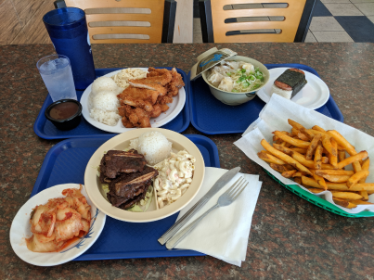
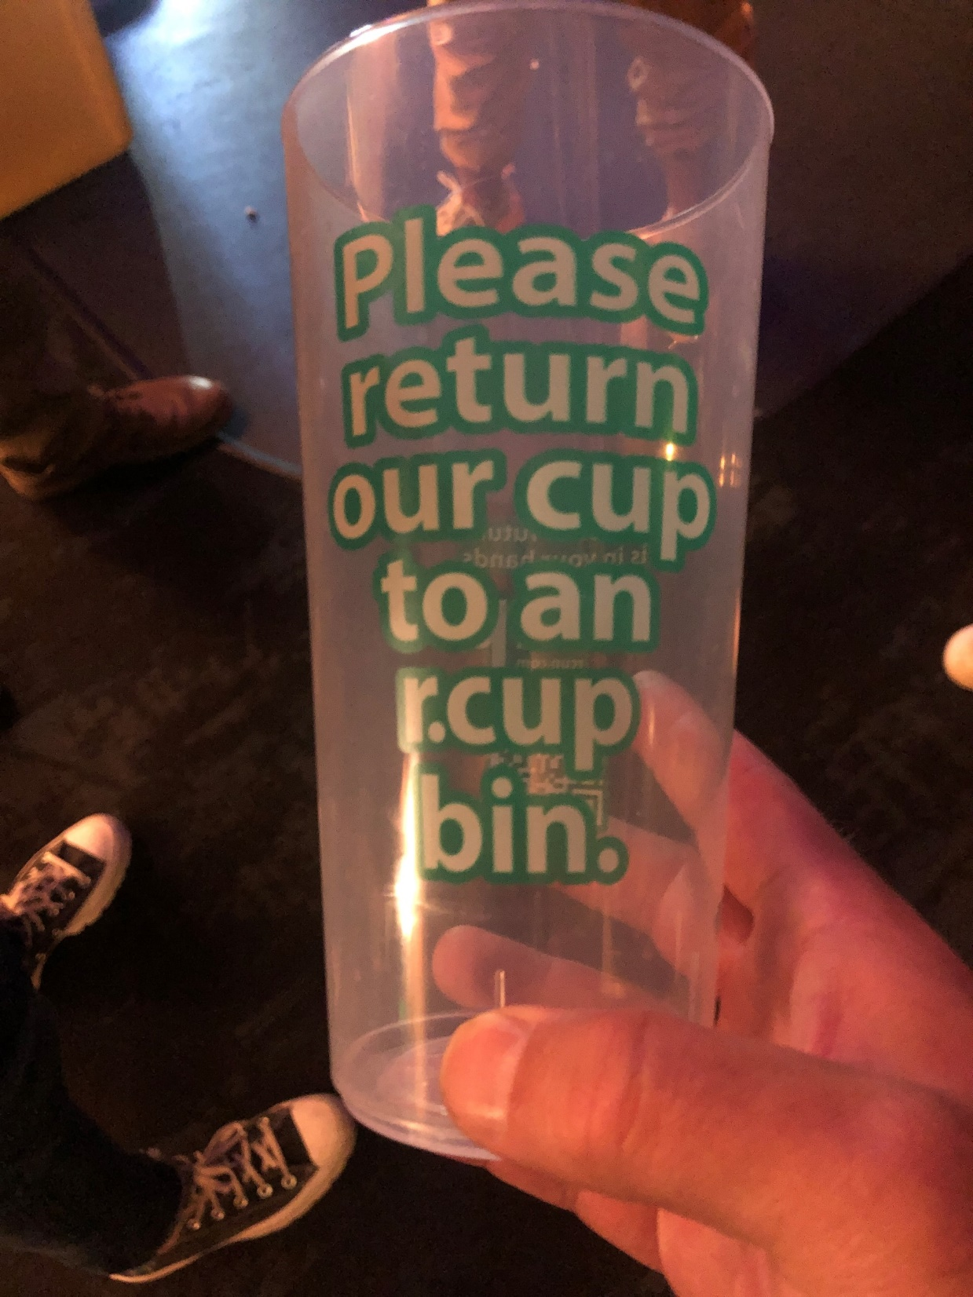
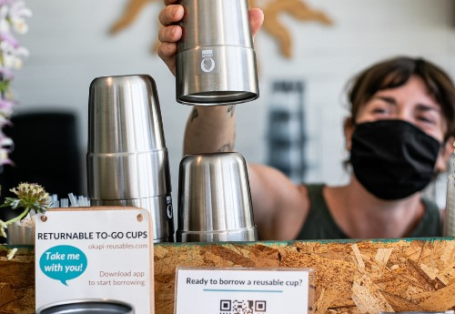
Reusables in Action
Honolulu BBQ worked with ReThink Disposable to switch to reusable foodware for on-site dining.
Okapi is currently working with 10 cafes in the city of Alameda to offer returnable to-go cups.
Now at the Warfield in SF and coming soon to Alameda County, r.Cup specializes in reusable cups for venues and special events.
Notes:
Honolulu BBQ worked with ReThink Disposable to switch to reusable foodware for on-site dining. Honolulu BBQ washes their own reusable foodware. ReThink has worked with hundreds of businesses and every single one of them has saved money by switching to reusables for on-site dining.
Okapi is currently working with 10 cafes in the city of Alameda to offer returnable to-go cups. Customers can borrow a cup and then return it to any participating café, and the cafes then wash the cups in-house.
Now at the Warfield in SF and coming soon to Alameda County, r.Cup specializes in reusable cups for venues and events. r.Cup delivers clean empty cups to the venue and collects the dirties for washing. They are currently building a dedicated wash hub, which will enable them to greatly expand their capacity.
In Pton: World Icicles, in process, replacing plastic spoons and trying a reusable tumbler for boba.
Main STreet Brewing in 2021 – stainless steel sauce cups and straws to replace plastic
Namaste Pizza – sauce cups, plates, utensils
Experience Burma – chopsticks, straws, kids cups
Fairgrounds opportunities?

Slide 11
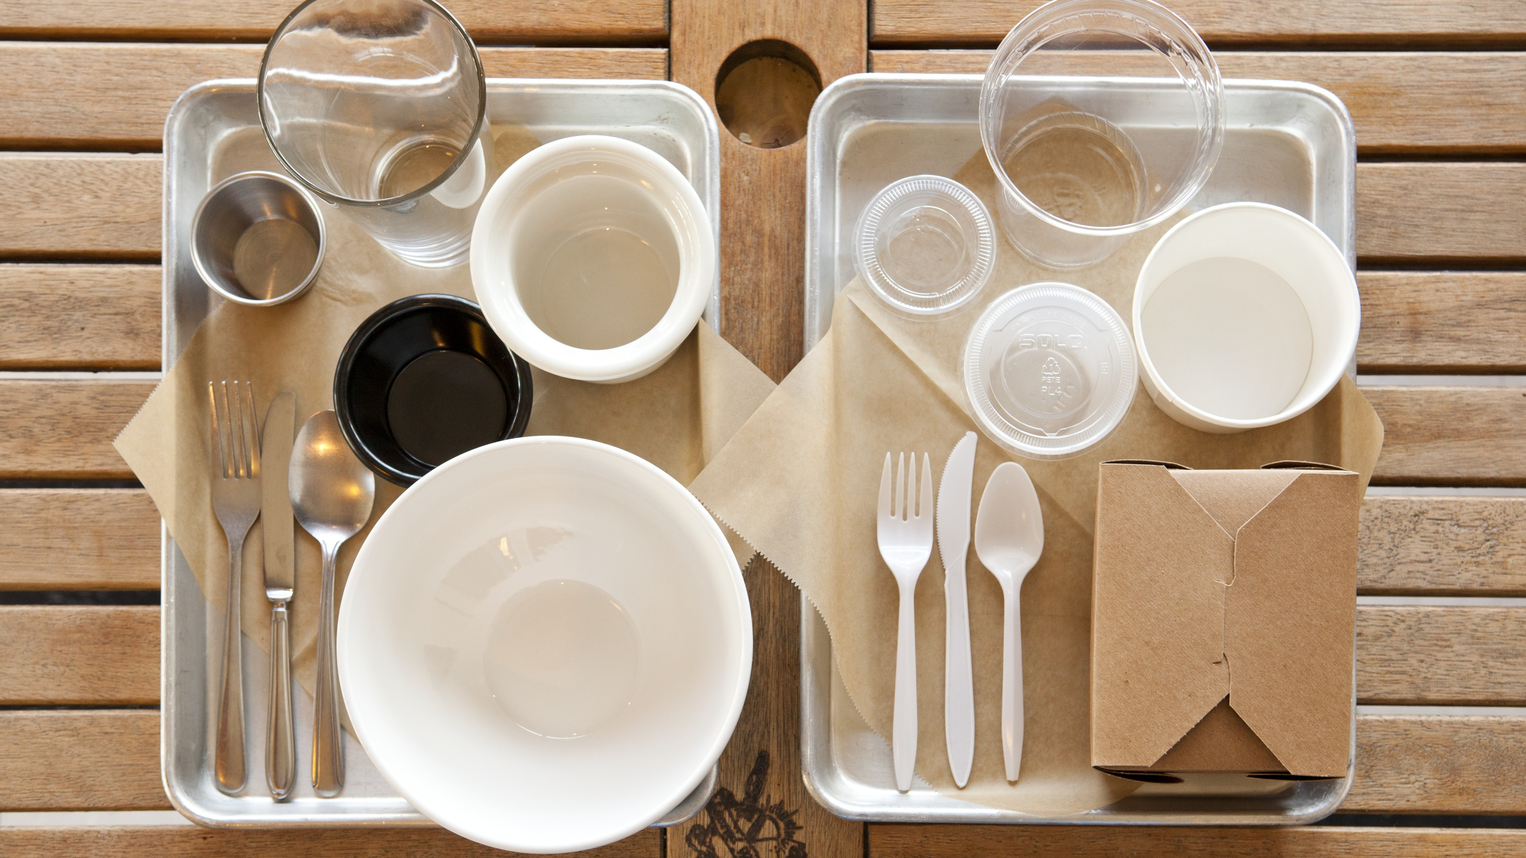
Model Ordinance

Slide 12
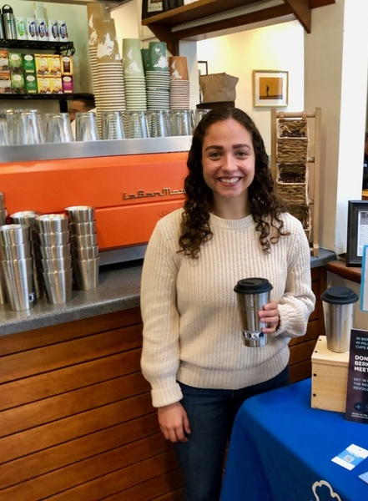
Foodware Policy – The Big Picture
Goal: Reduce consumption of single-use items!
Reuse First
Comprehensive and Innovative
Modular / Customizable

Slide 13
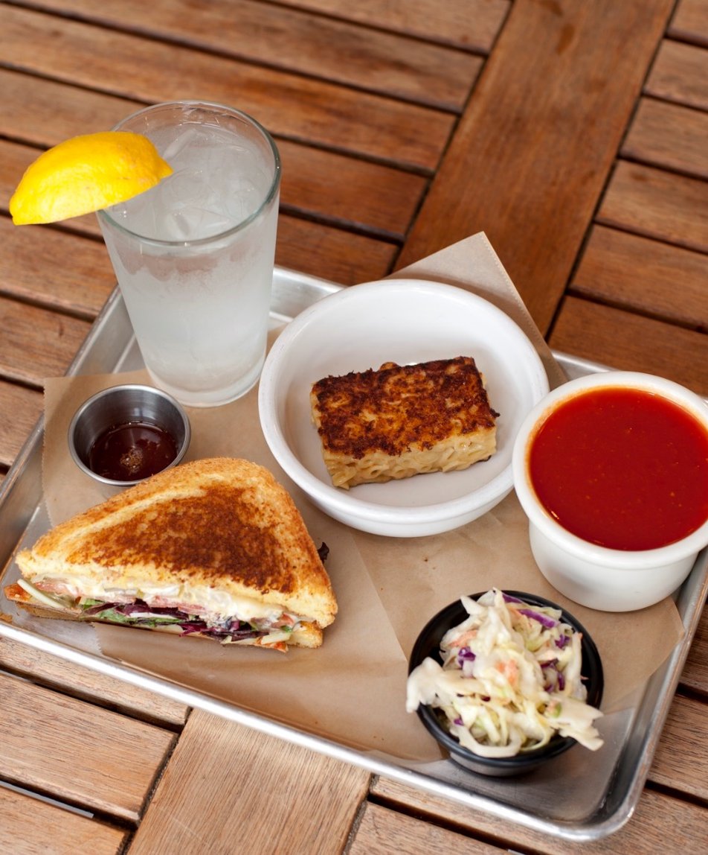
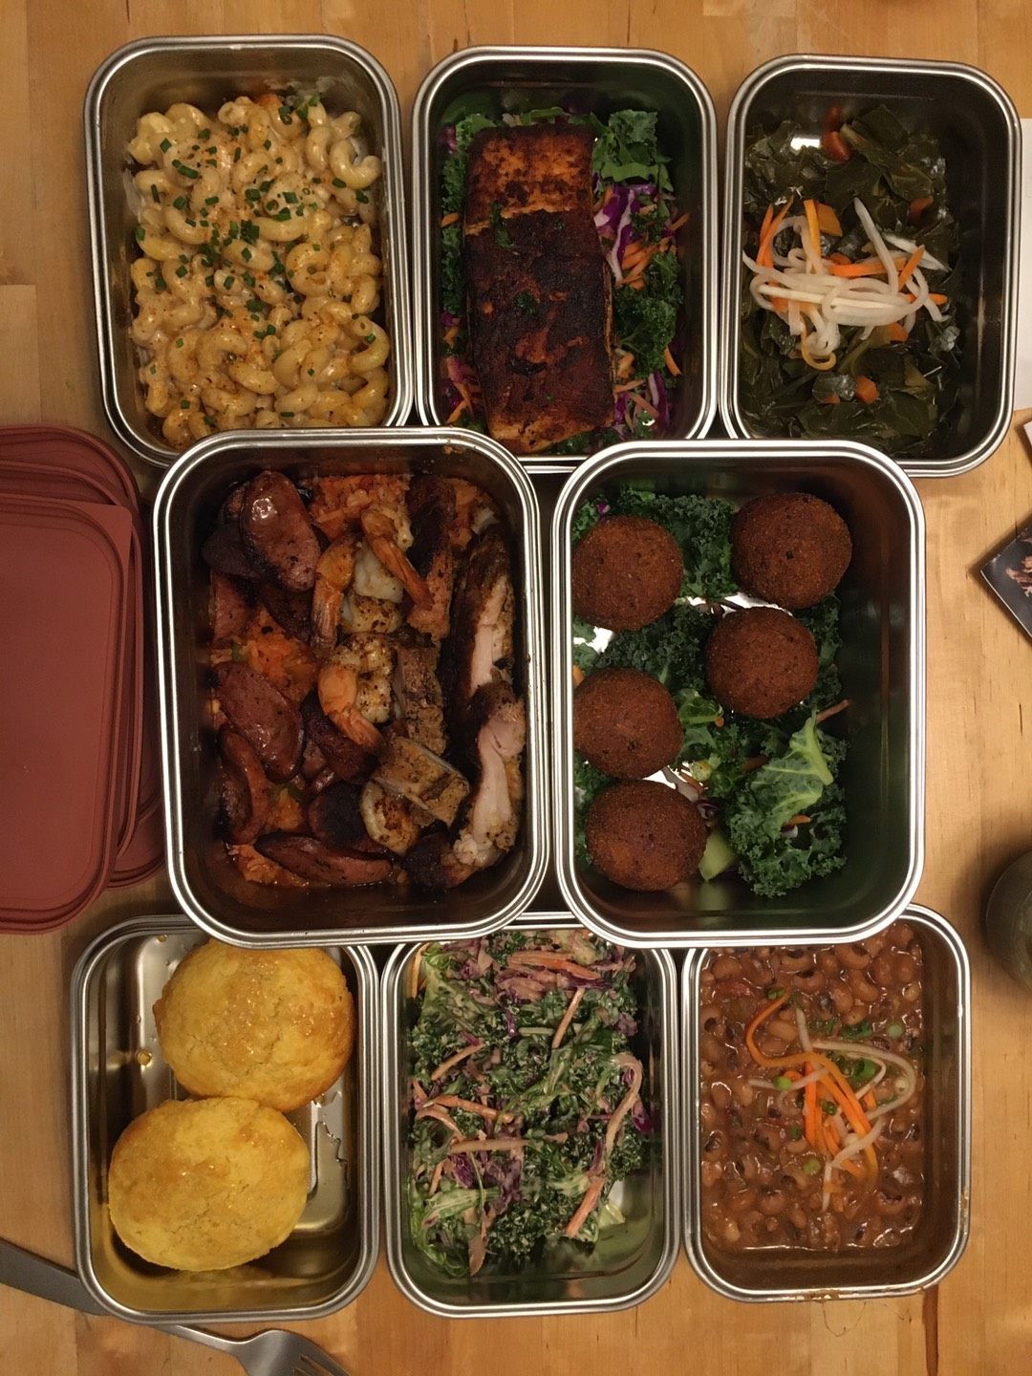
Reusables – Required for dine-in, BYO Always Allowed
Effective 12 months after adoption
Reusable foodware required for all
dine-in establishments
Waivers available (dishwashing capacity) but expire in the event of a remodel.
Must accept customer-provided reusables (BYO)
Vendors operating on City property must comply as well as leases, contracts, etc.

Slide 14
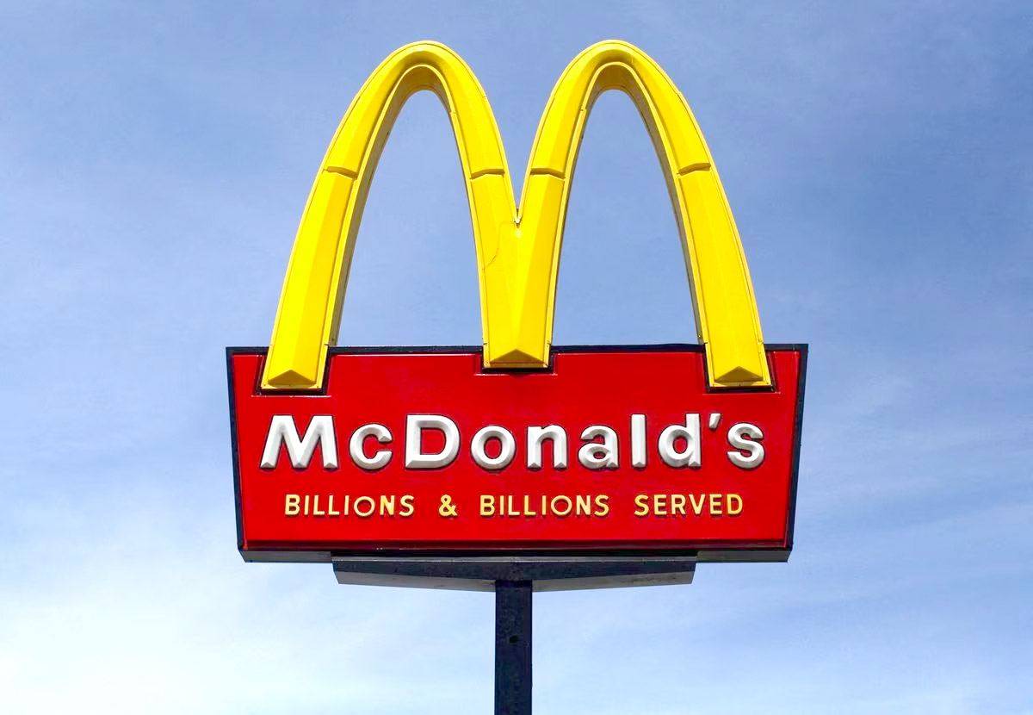
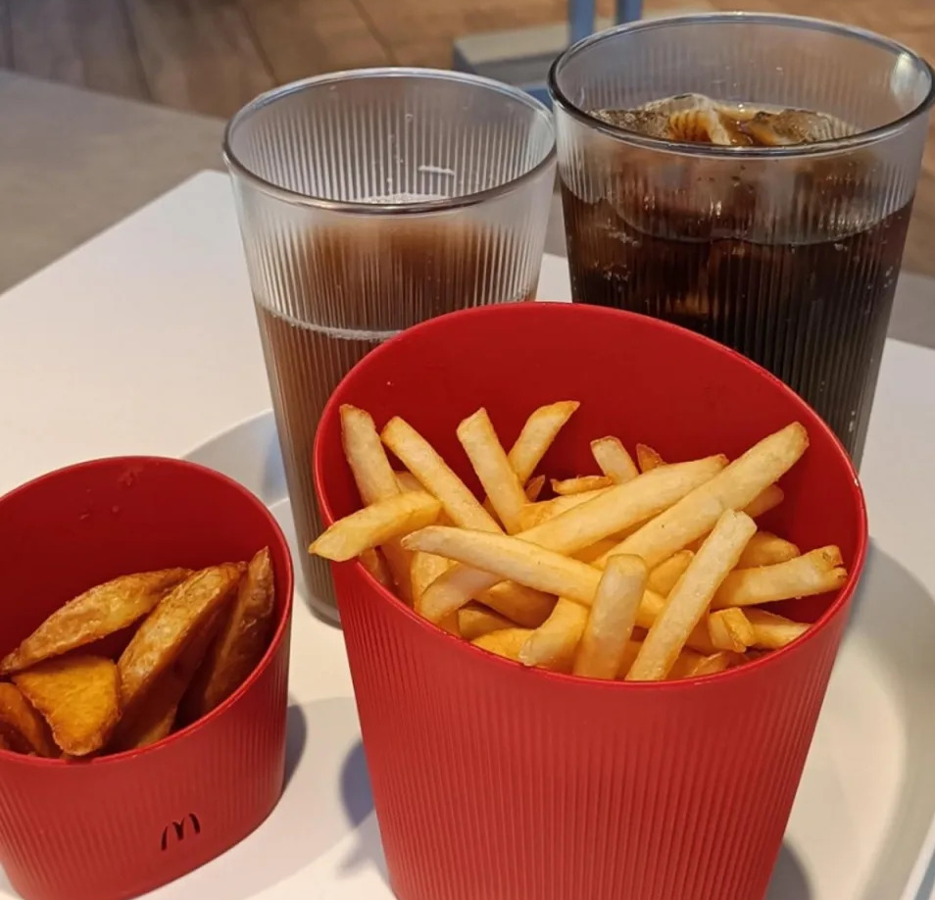
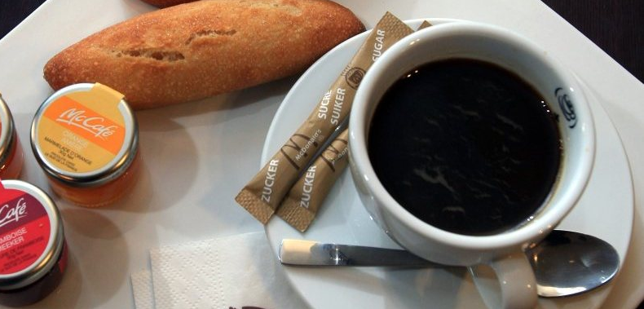
SAVED

Slide 15

Disposable Cup and Container Charge
Effective 12 months after adoption
Options!
  Charge for cups only, or add containers
  $0.25/disposable item, up to $1.00
  $0.25 flat charge
  $0.25 discount for customer BYO
Business keeps the money
Includes takeout order/delivery platforms
25¢
Notes:
We are interested in your input, it will help inform how the City drafts the ordinance.

Slide 16
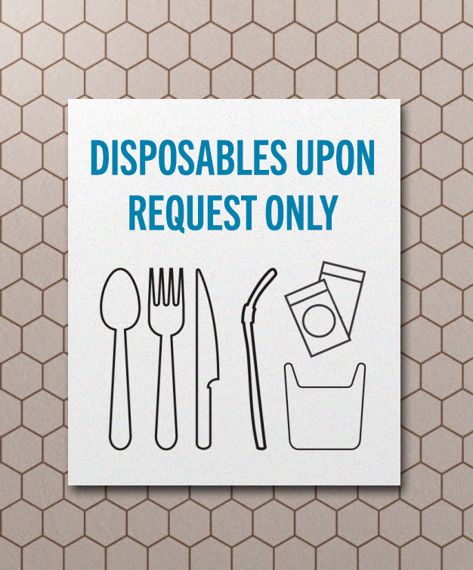
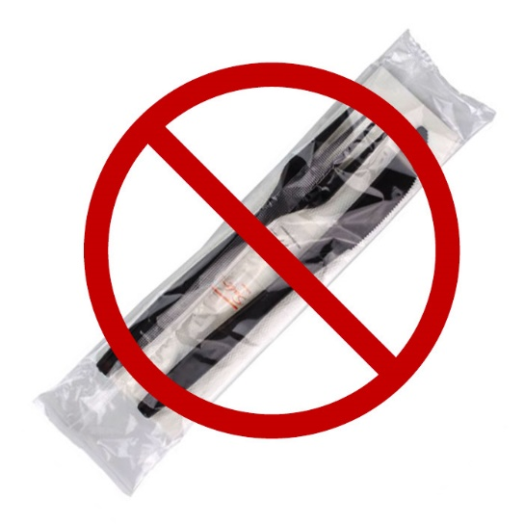
Accessories Only Upon Request
Effective Immediately
Accessories: utensils, napkins, condiment packets, cup sleeves/tops
Disposables only provided upon request, for take out
Condiments from bulk dispensers or reusable containers
Medical exemption upon request
No bundling!

Slide 17
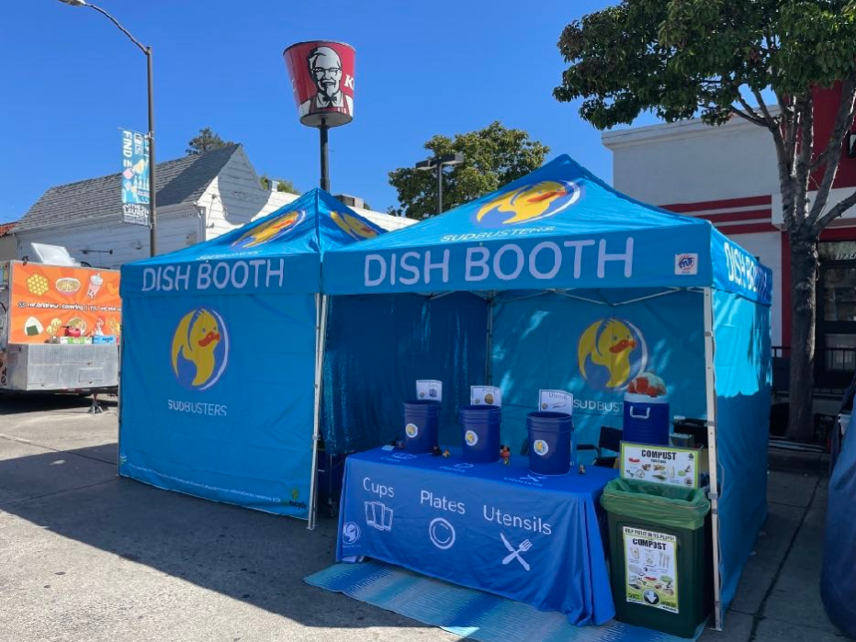
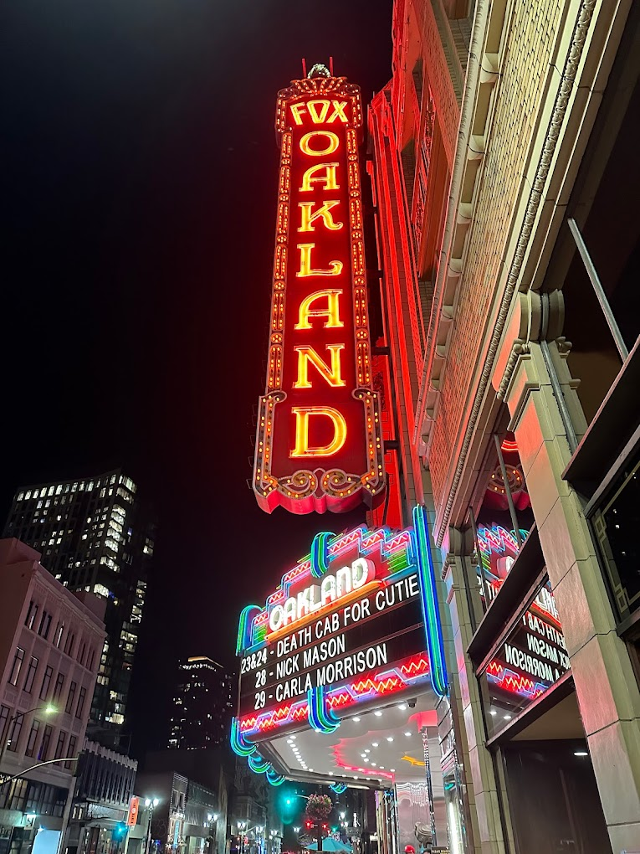
Reusable Cups at Venues and Events
Effective 18 months after adoption
Reusable cups for all non-packaged beverages sold
Attendees can BYO
Events: at least 25% reusables, ramps up to 50%
Tracking/Reporting requirement

Slide 18

Compliant Disposable Food Ware
Effective 12 months after adoption
Certified free of toxins
Compostable, third party certified
Extra: No retail sales of noncompliant foodware

Slide 19
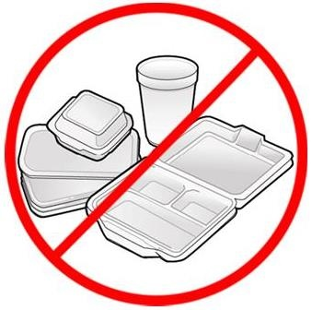
Polystyrene
Effective 12 months after adoption
No sale of polystyrene items:
  Packing peanuts
  Styrofoam coolers
  Pool or Beach toys unless encapsulated
  Docks/water equipment unless encapsulated
  Meat, produce trays, egg cartons

Slide 20
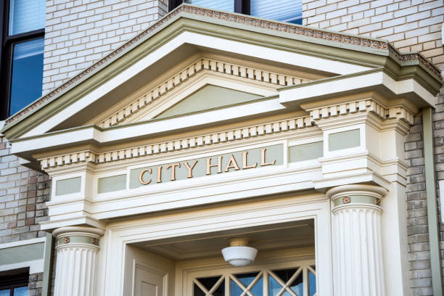
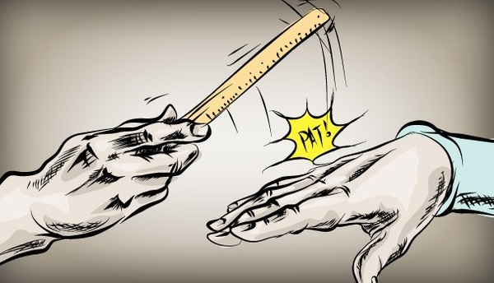
Waivers and Enforcement
Waiver Process outlined
  Discretion of City
  Not permanent
Infractions
  Up to $100 for first violation
  $200 for 2nd violation
  $500 subsequent violations (per year)

Slide 21
StopWaste’s Role
Assist with customization based on local priorities
Support data analysis and incorporating lessons learned
Support City Council presentations
Technical assistance and incentive funding for businesses
Develop general outreach materials (for countywide use)
Market development and grant funding to support infrastructure growth
Notes:
SB 54, comprehensive EPR legislation that is expected to regulate some of the materials we are speaking about.

Slide 22
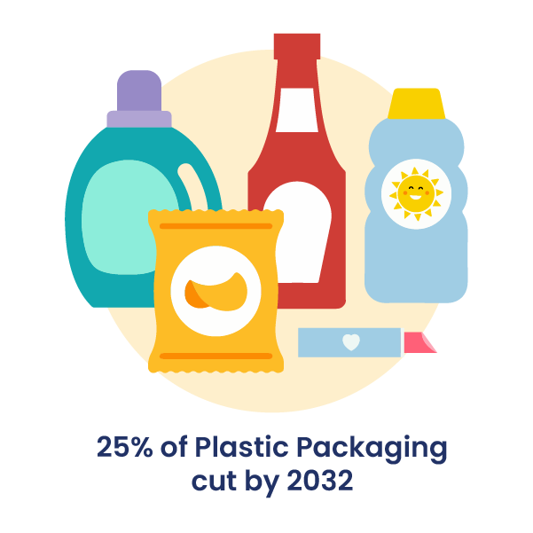
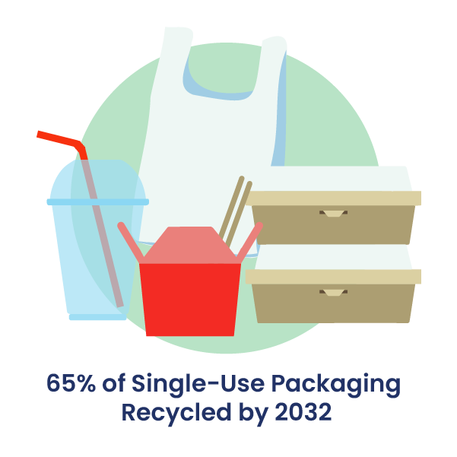
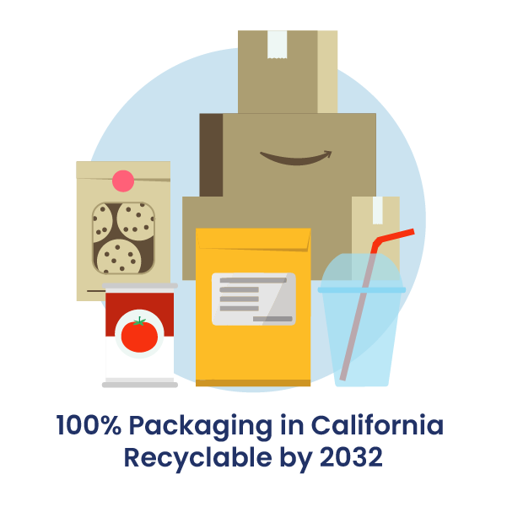
SB 54 statutory goals
Notes:
Plastic Pollution Prevention and Packaging Producer Responsibility Act (Allen, 2022)
Shifts packaging pollution burden from consumers to producers
Raises $5 billion from industry to cut plastic pollution and support disadvantaged communities
Add’l funds from PRO to cover costs to collect and process covered materials

Slide 23
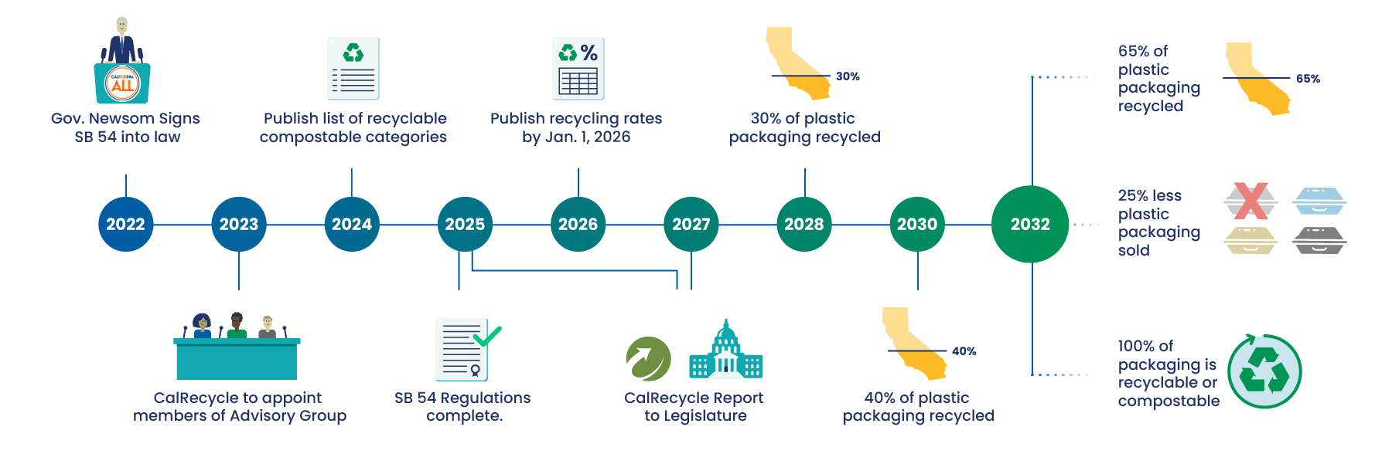
SB 54 timeline
Notes:
Long implementation timeline.
We are now providing input to CalReycle through the rulemaking process. TB is also appointed to Advisory Board so SW in a good position to participate in the process.
We don’t know exactly how SB 54 will impact local policies like a foodware ordinance but one of the next steps in the rulemaking process is for CalReycle to publish a list of the materials covered by the law – so defining what is recyclable and compostable and therefore must be collected by jurisdictions for recycling/compost. If the City wanted to make sure a certain material is not included, for example if the city wanted to prohibit compostable plastics, they could pass a local ordinance before CalRecyle publishes their list. If this happens after the CalReycle list, City may be responsible for collecting materials they do not want to include in their program, just because the state will require it through SB 54.

Slide 24

Discussion and Feedback

Slide 26
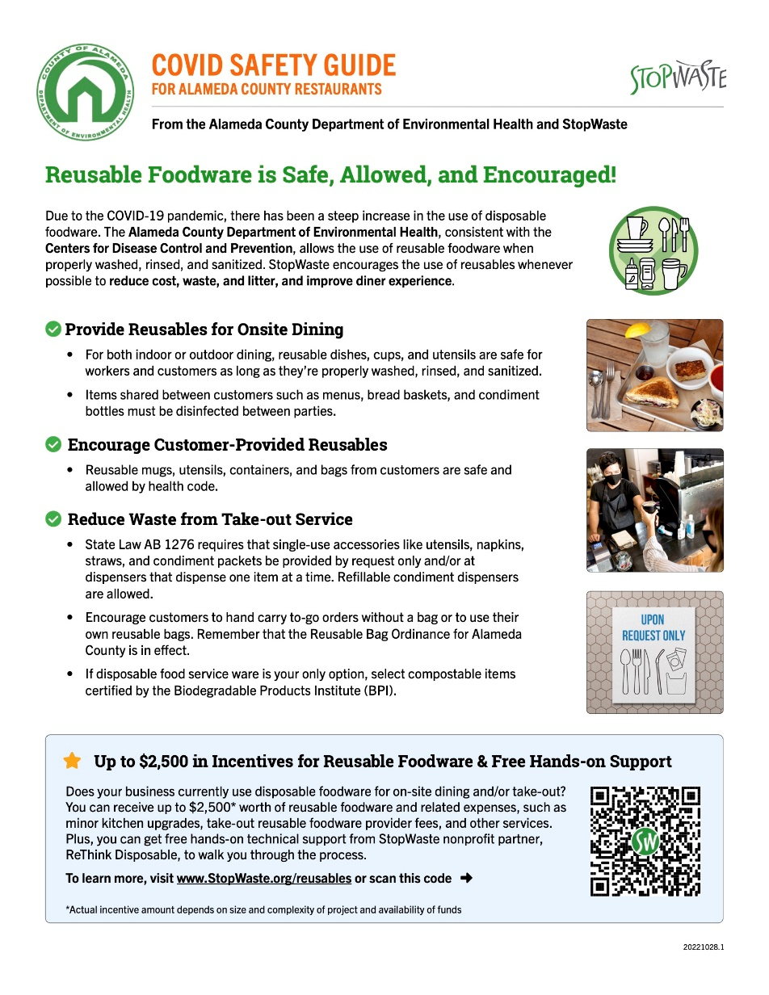
Outreach and Education
Safety of Reusables:
  Validated by Alameda County Environmental Health Department
  “Leave-behind” for restaurants
  Translation and outreach to underserved communities
Updated website content:
  www.stopwaste.org/reusablefoodware
Notes:
Our outreach to date has primarily focused on the safety of reusables and includes a one-page flyer, pictured, that StopWaste developed in partnership with the County Environmental Health Department, designed to inform businesses that it is safe to accept customer provided reusables and to use reusables of any type as long as they are properly cleaned and sanitized between use.
Upcoming outreach plans include a fact sheet for businesses on SB 1276 or the “accessories upon request” law, a new landing page on the StopWaste website to direct interested food businesses on switching to reusables, revised TA leave behinds (in multiple languages), and additional case studies. We are also in the beginning phases of exploring a larger campaign to support the mission of advancing reusables in our county.

