Slide 1

Wheels Bus Update
Committee on Energy and the Environment
November 15, 2023

Slide 2

Agenda
Welcome
Overview of LAVTA and Wheels
Ridership Update
Wheels in Motion
Conversion to Zero Emissions Buses
Atlantis Satellite Facility
Questions and Discussion

Slide 3
Overview of LAVTA
Livermore Amador Valley Transit Authority (LAVTA)
  Formed by a Joint Powers Agreement
  Cities of Livermore, Pleasanton, Dublin and unincorporated Alameda County
  Operates Wheels bus service
Local, express, Rapid and school-focused routes
Paratransit
Go Tri-Valley Uber/Lyft

Slide 4
Ridership Update
90% of pre-pandemic bus service is operating
Overall ridership is 70% of pre-pandemic levels
  School-focused routes are 100%+
  Weekend ridership nearly 100%
Seeing greater use of Wheels for all trip purposes
  Wheels carrying more transit dependent riders than it did pre-pandemic
  Wheels is essential!

Slide 5
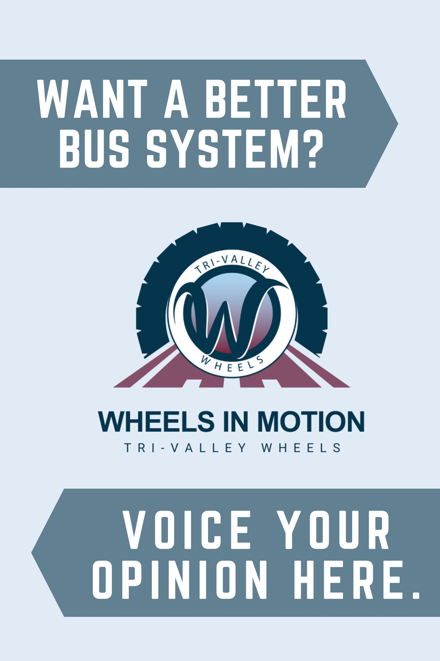
Wheels in motion
BART changed its train service on Sept. 11
  Trains now operate every 20-minutes, 7-days a week
  Current Wheels system is timed to connect with BART every 15-minutes
This is a challenge... but also creates an opportunity to re-look at overall service levels and the distribution thereof
Wheels staff executed an outreach campaign in September 2023 to solicit input on three different bus network

Slide 6
Wheels in motion, Con’t
Three Draft Scenarios Developed for Public review: All cost neutral
Status-quo. Would formalize current service setup and levels, including formal discontinuation of still-suspended routes.​
Frequency-focused. Would increase frequencies in key travel corridors and reduce or eliminate service on certain local routes.​
Coverage. Would reduce the 15-minute service corridors to 20 minutes to align with BART, and restore service in several areas that are currently without bus service.

Slide 7
Wheels in motion, Next steps
Over 230 survey responses received​
Overwhelming supportive of scenario 3
  More coverage over frequency, better connectivity to BART
Public Hearing scheduled for Dec. 4, 2023
If approved, new bus network will be unveiled in Spring 2024

Slide 8
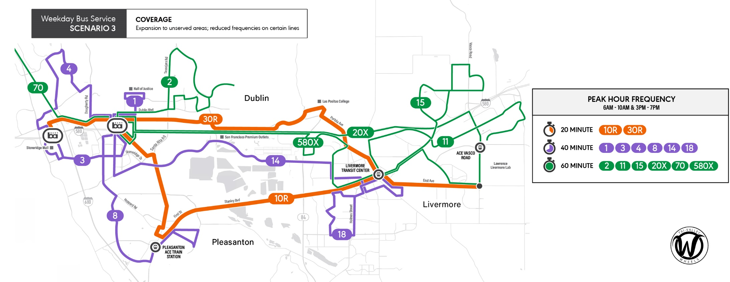
Preferred Bus Network Scenario

Slide 9
Moving to zero emissions buses
2018 Innovative Clean Transit (ICT) mandate from the State of California
  Requires 100% zero-emissions buses (ZEB) by 2040
  Different schedule for small versus large transit agencies
  Small agencies (like LAVTA) must begin purchasing ZEBs in 2026
    January 1, 2026 - 25% of all new bus purchases must be zero-emission
    January 1, 2027 - 50% of all new bus purchases must be zero-emission
    January 1, 2028 - 75% of all new bus purchases must be zero-emission
    January 1, 2029+ - 100% of all new bus purchases must be zero-emission
State of California required transit agencies to approve an ICT Plan that specifies how they will meet the ICT mandate

Slide 10
LAVTA’s ICT Plan
LAVTA’s Innovative Clean Transit plan was approved by the LAVTA Board in April 2022
  ICT plan calls for hydrogen/fuel cell technology for LAVTA’s entire fleet
  Battery-electric buses were ruled out due to range issues
  Mixed fleet ruled out due to infrastructure requirements
  Synergy around hydrogen in the 580 corridor with future Valley Link rail line
LAVTA plan results in 100% zero-emissions buses (ZEB) by 2037
  Purchase first ZEBs in 2025

Slide 11
Getting ready for fuel cell buses
Near-term: Getting ready for hydrogen
  LAVTA received State of California grant (2022) to construct a hydrogen fueling station at satellite Atlantis facility
    Project will move into construction phase in mid/late 2024
  Retrofitting two maintenance bays with ventilation and hydrogen detection systems
  First fuel cell buses (up to 12) will be purchased in FY25
Long-term: Fully construct Atlantis Satellite Facility
  875 Atlantis Court, Livermore
ARCHES (Alliance for Renewable Clean Hydrogen Energy Systems)
  Up to $1.2B from Dept of Energy to support development of a hydrogen hub network in NorCal

Slide 12
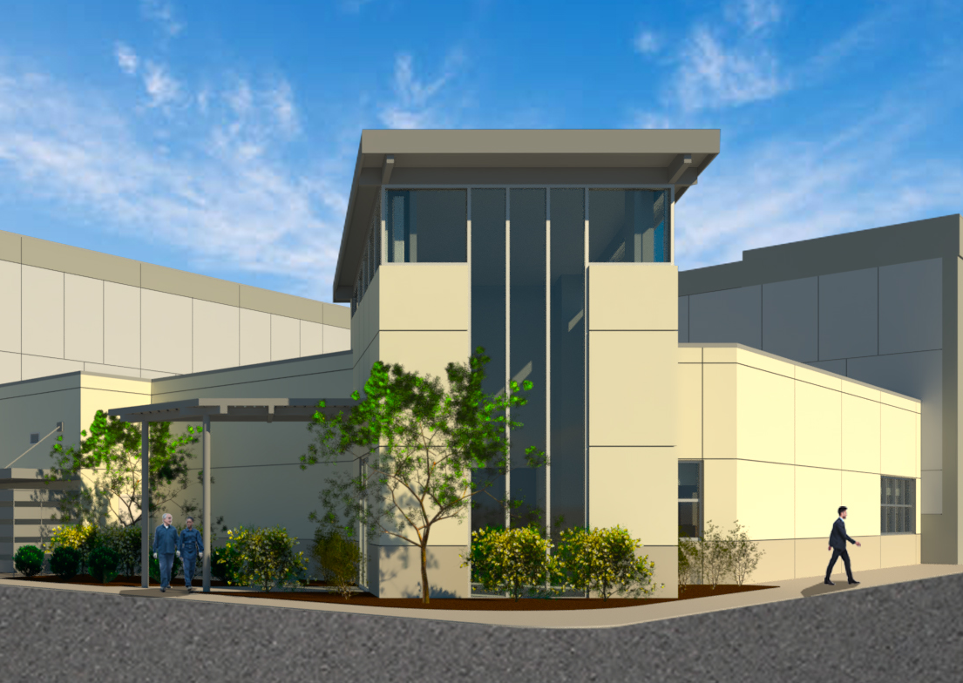
Atlantis satellite facility
LAVTA has a satellite facility (Atlantis) in Livermore
  Currently has diesel fueling station and bus wash
  60% design is complete on the operations and maintenance buildings to support hydrogen
  Will support up to 100 fuel cell buses once constructed
  LAVTA currently seeking funding for construction

Slide 13
Questions and Discussion
David Mark
Director of Customer Experience
dmark@lavta.org
www.wheelsbus.com

